Slide 1
Credit Card Customer Analysis
by Max Dinkelspiel

Slide 2
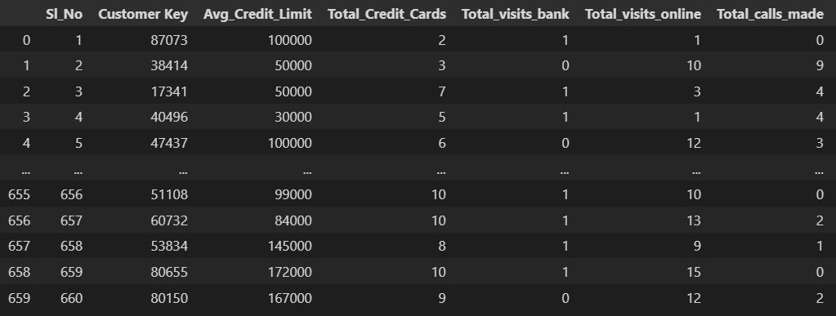
The Data
Credit Card Customer Data
Average Credit Limit
Total Credit Cards
Total Bank Visits
Total Visits Online
Total Calls Made
660 Rows
5 Columns that are relevant

Slide 3
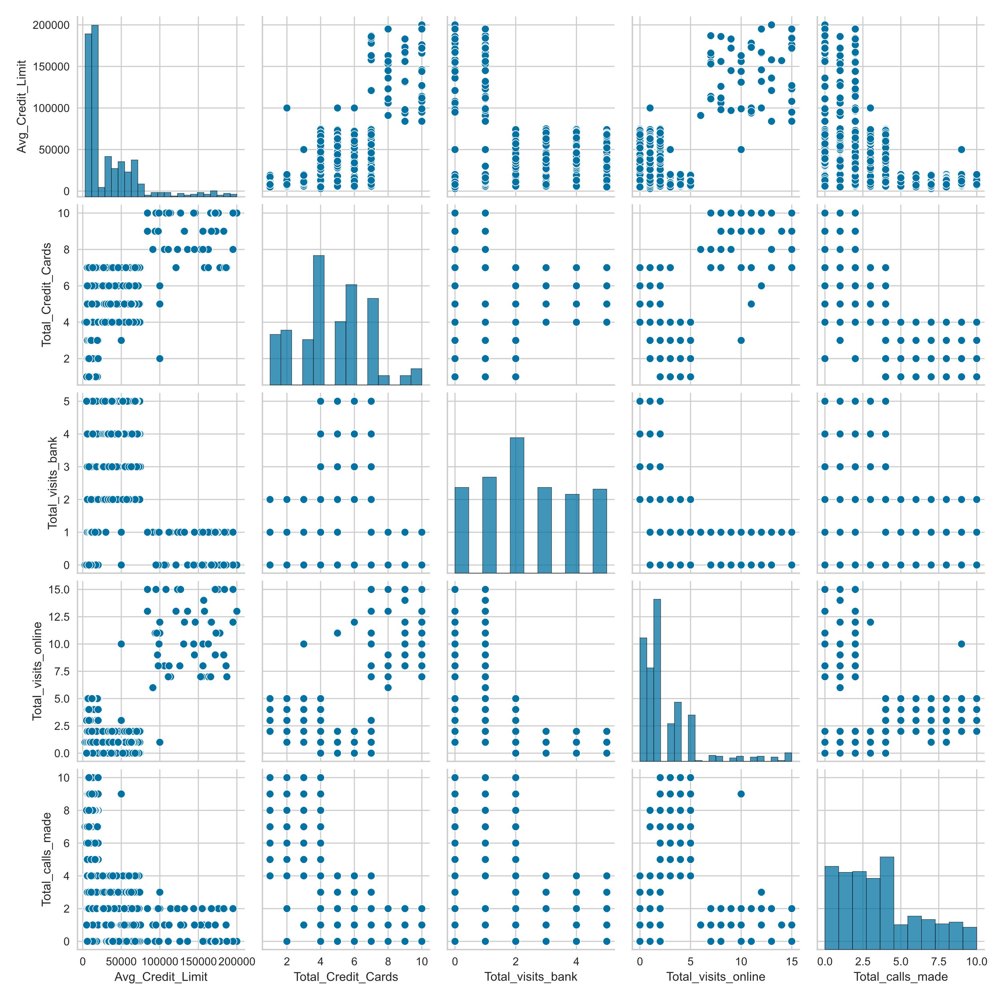
Initial Analysis
Maybe some clusters

Slide 4
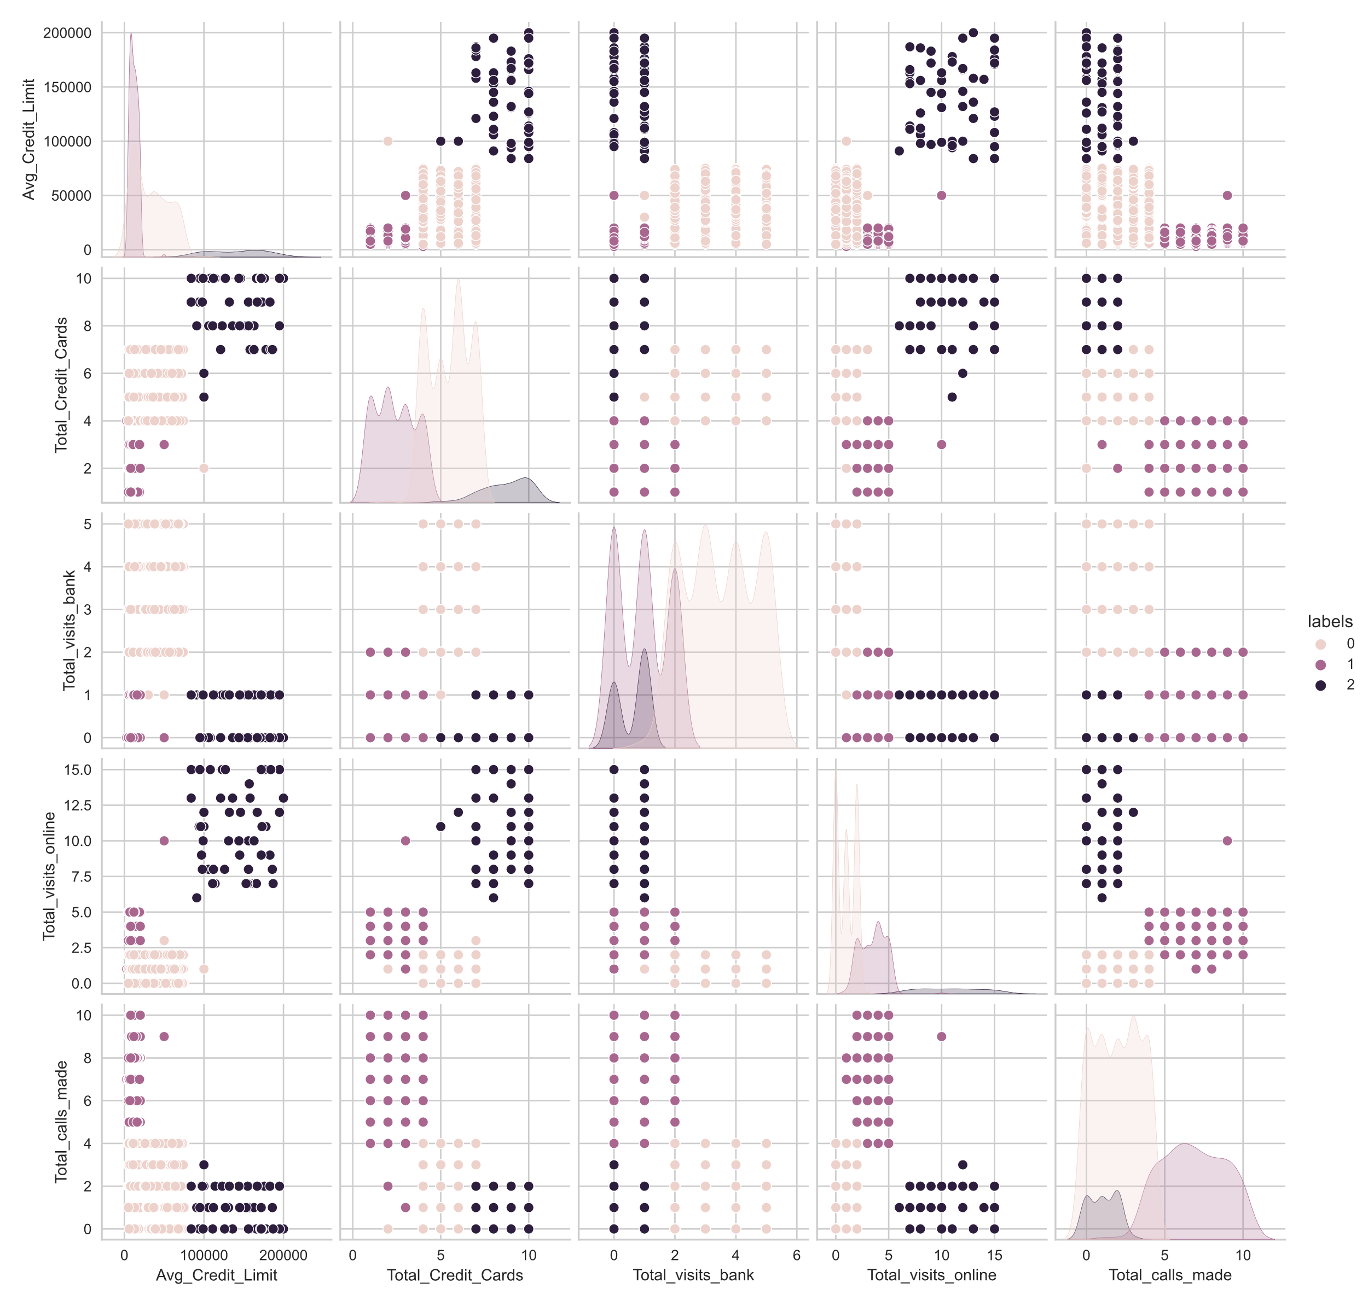
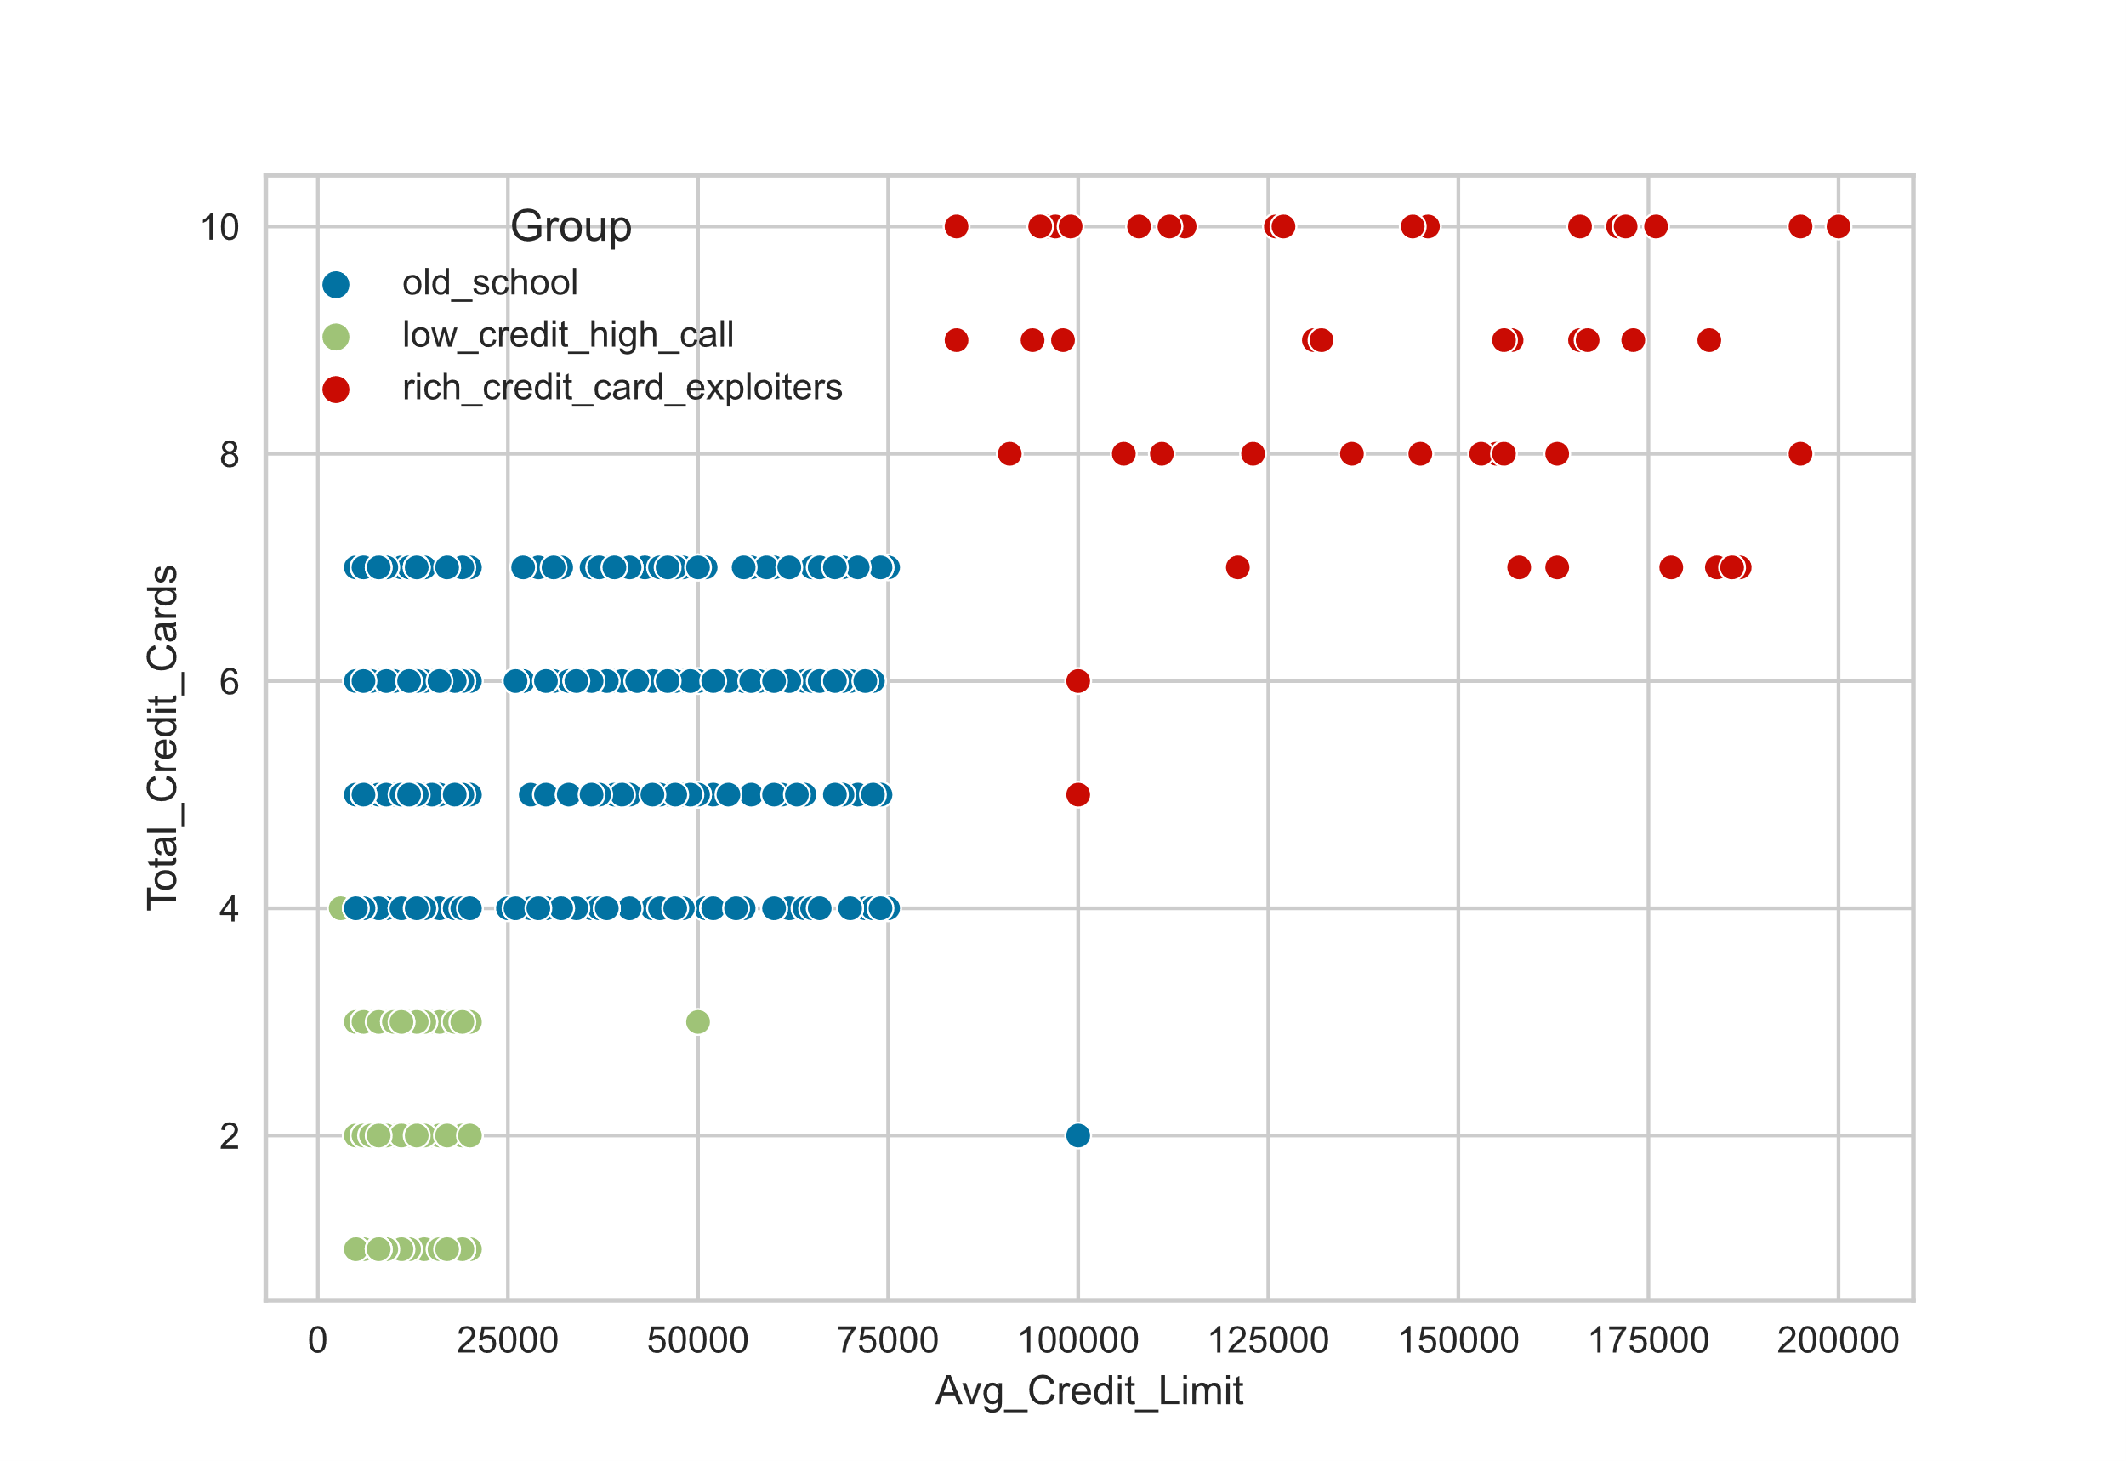
Initial Analysis
+ KMeans
I guess?

Slide 5
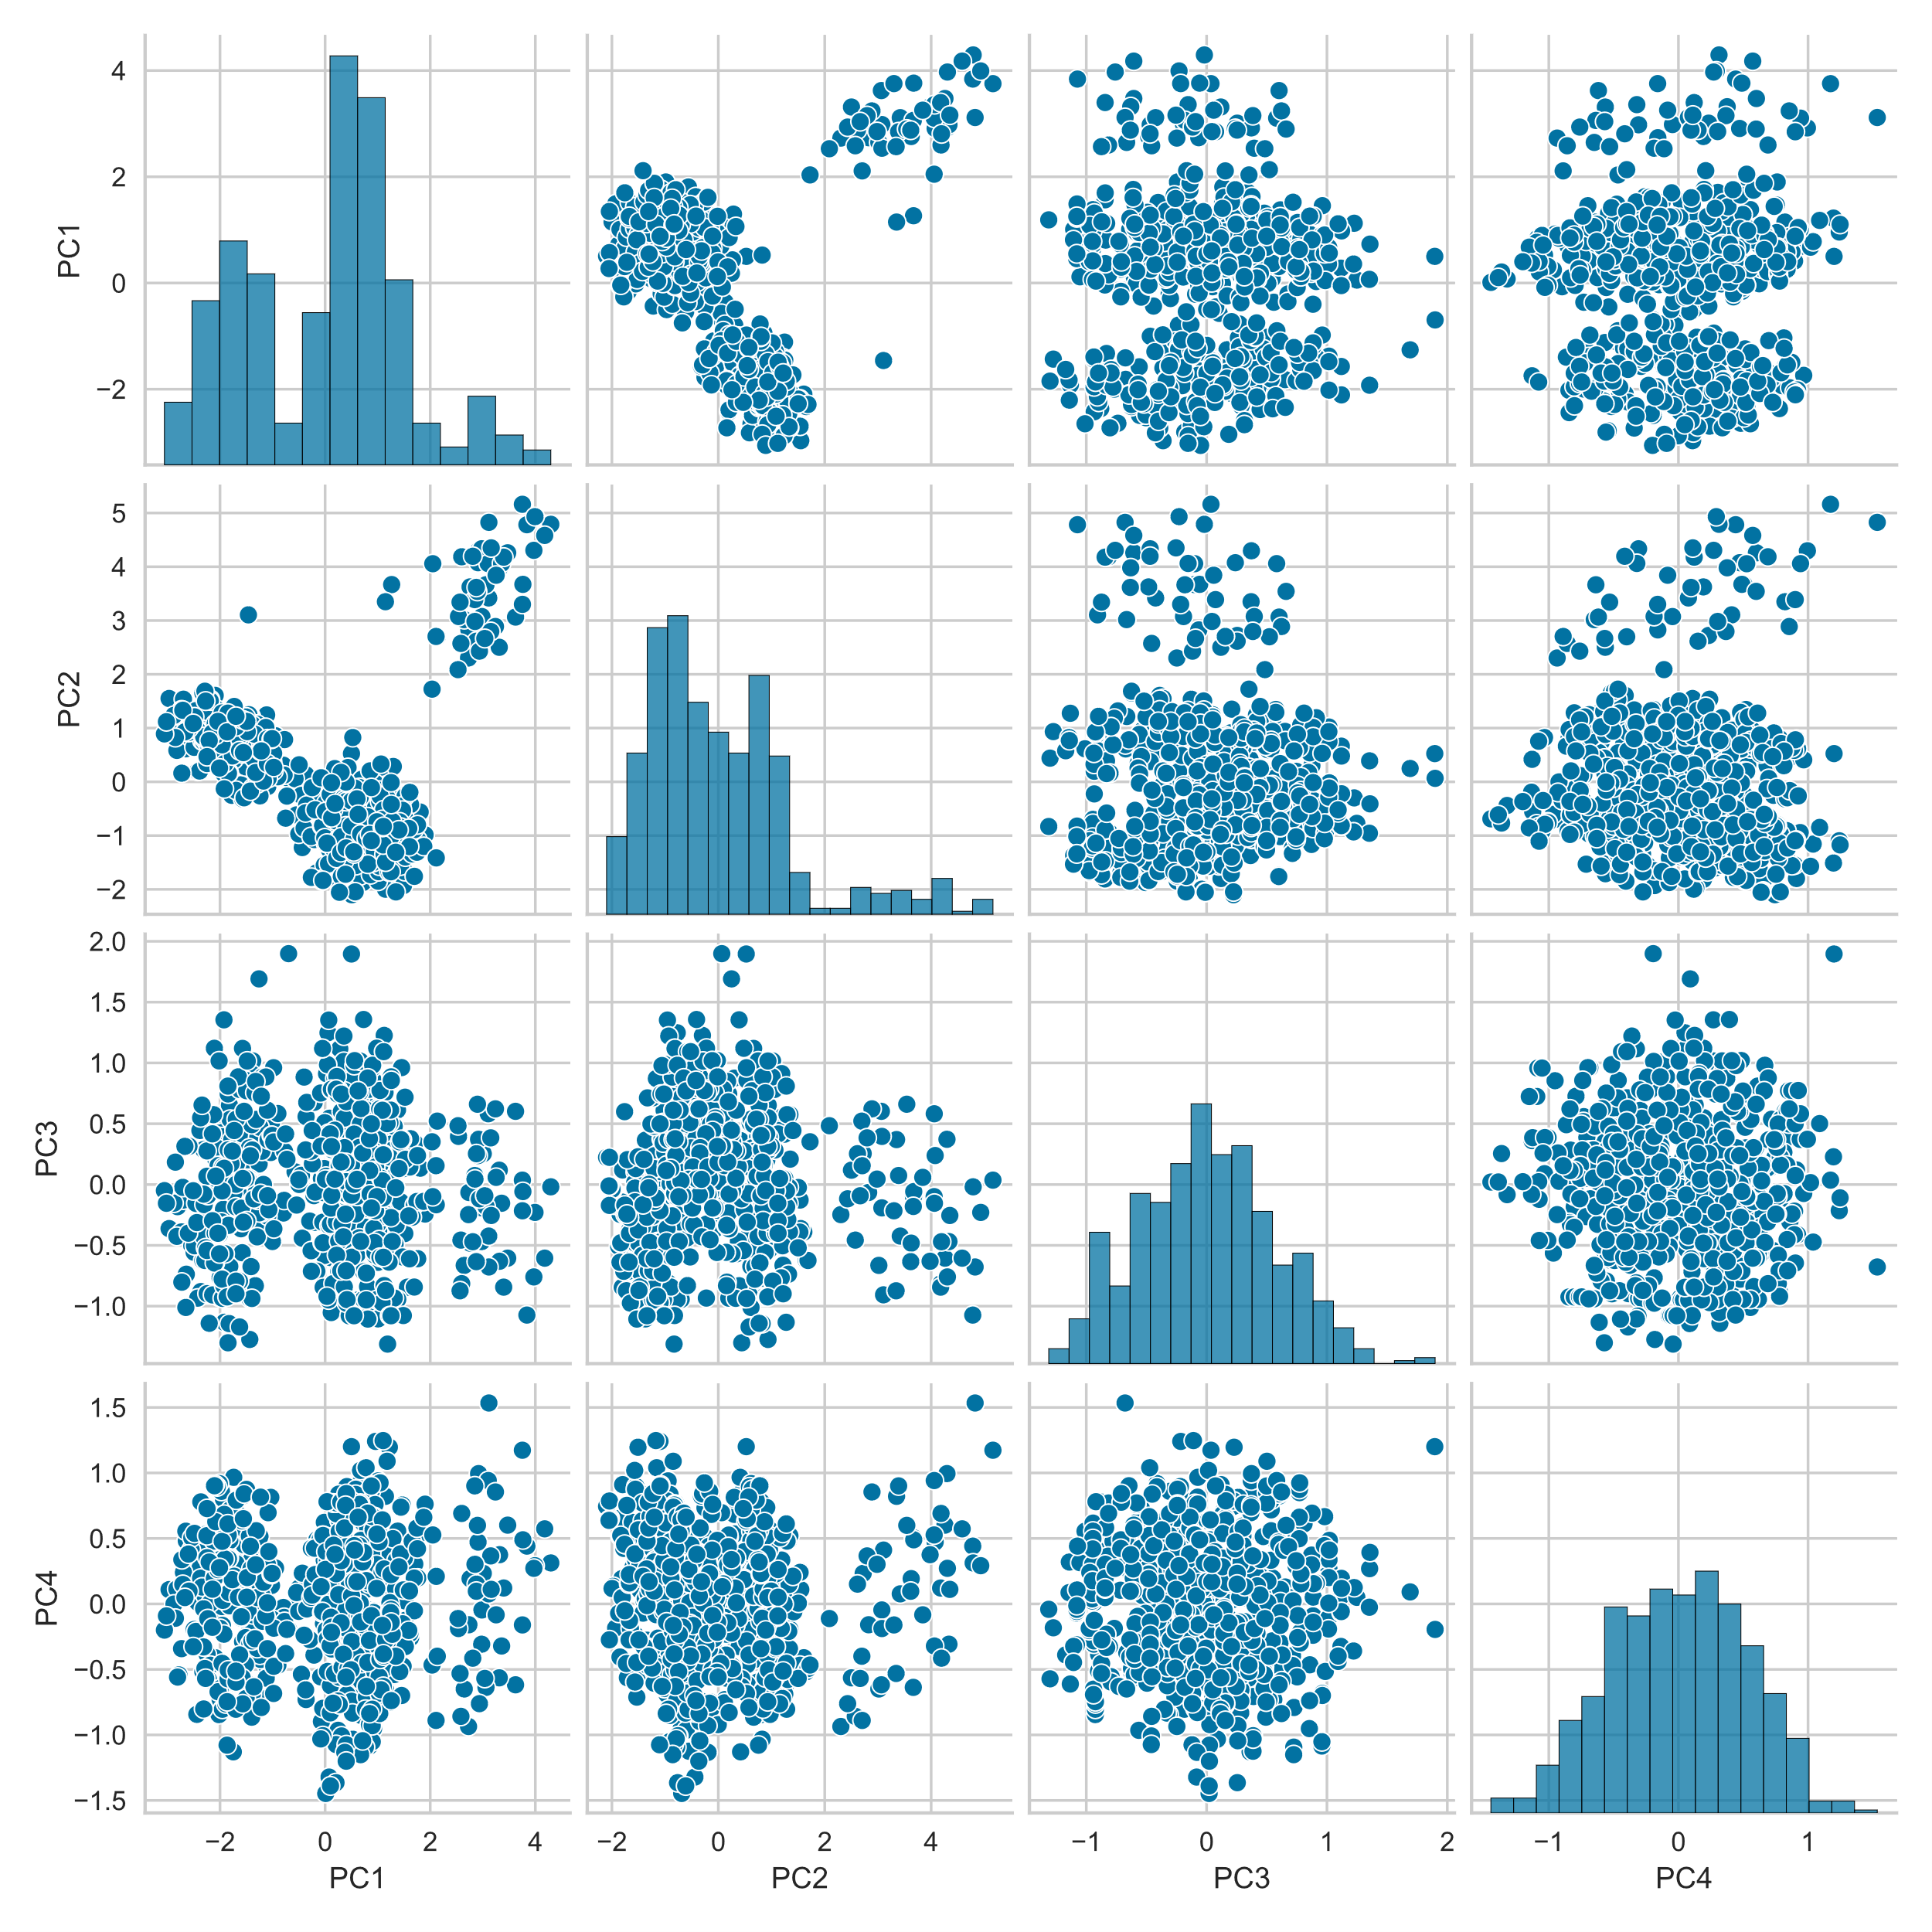
PCA
A lot clearer

Slide 6
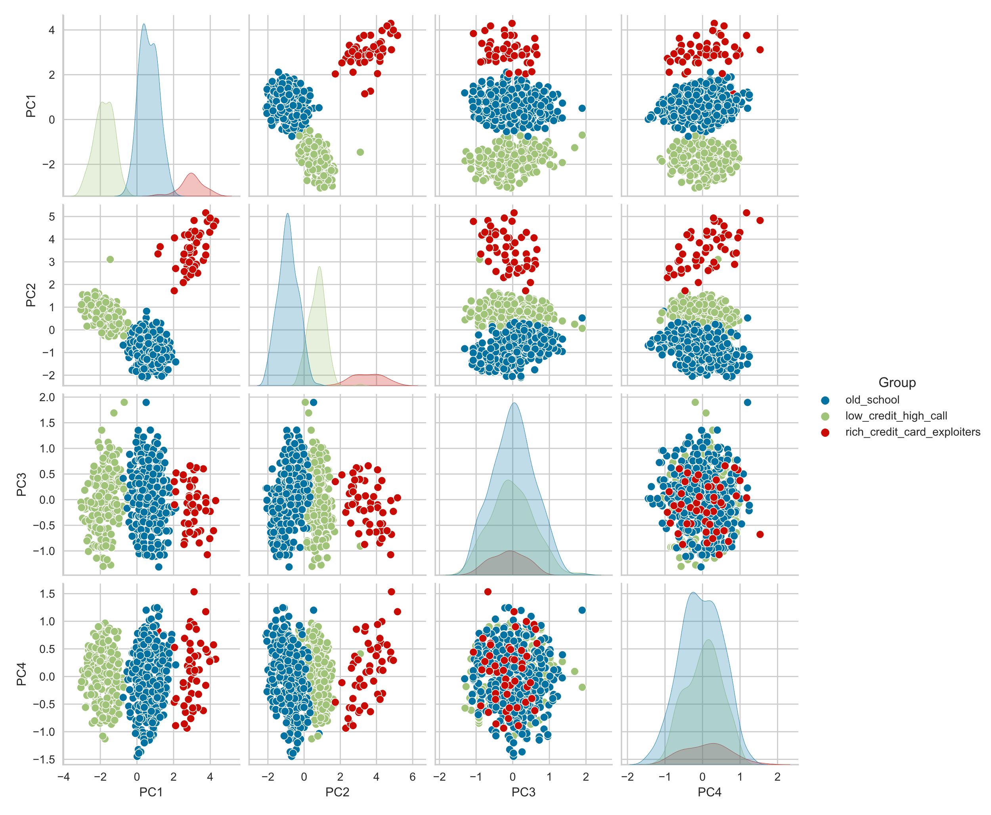
PCA KMeans
Even clearer

Slide 7
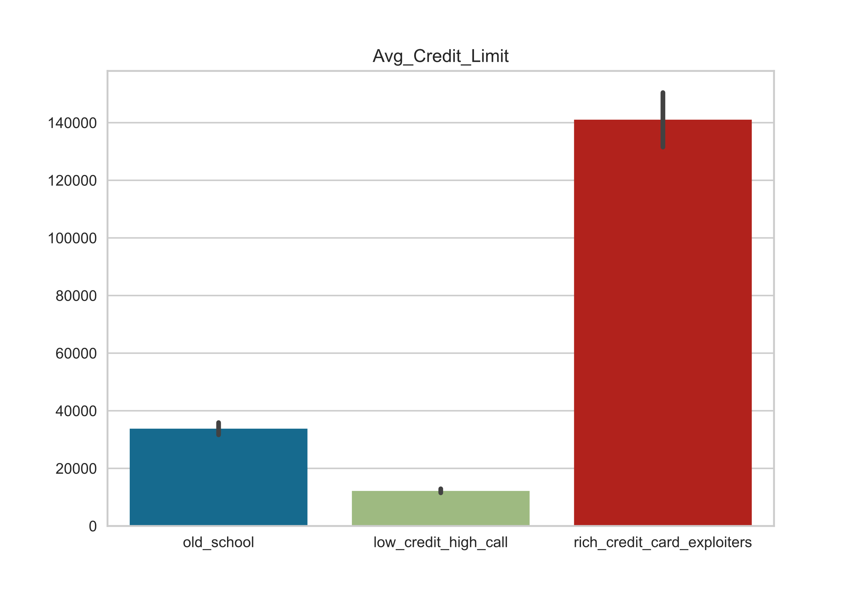
The Groups
Old School
Middle – Income
Low Credit High Call
Low - Income
Rich Credit Card Exploiter
High - Income

Slide 8
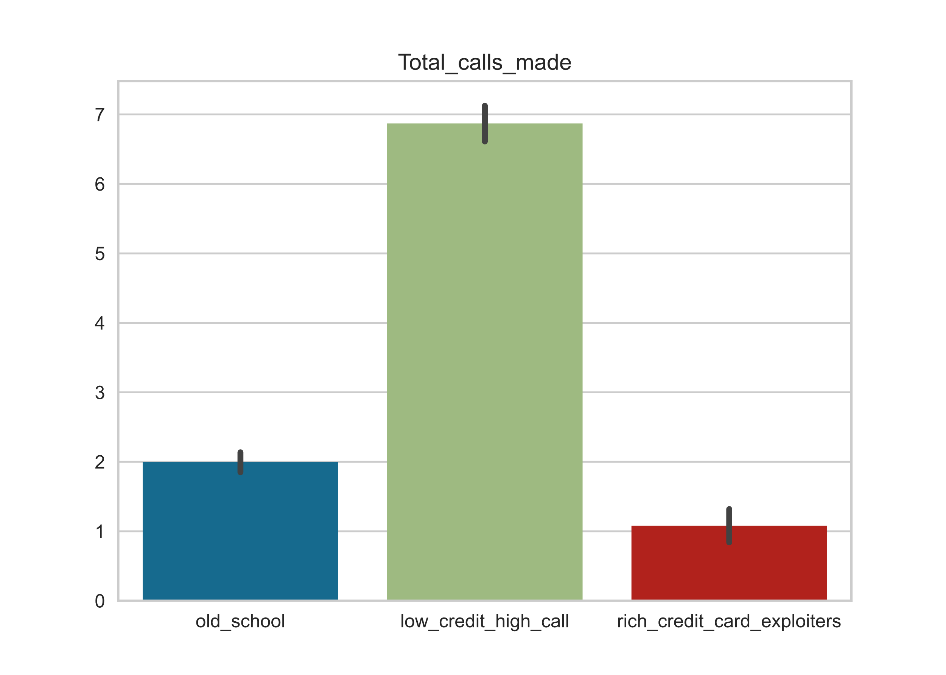
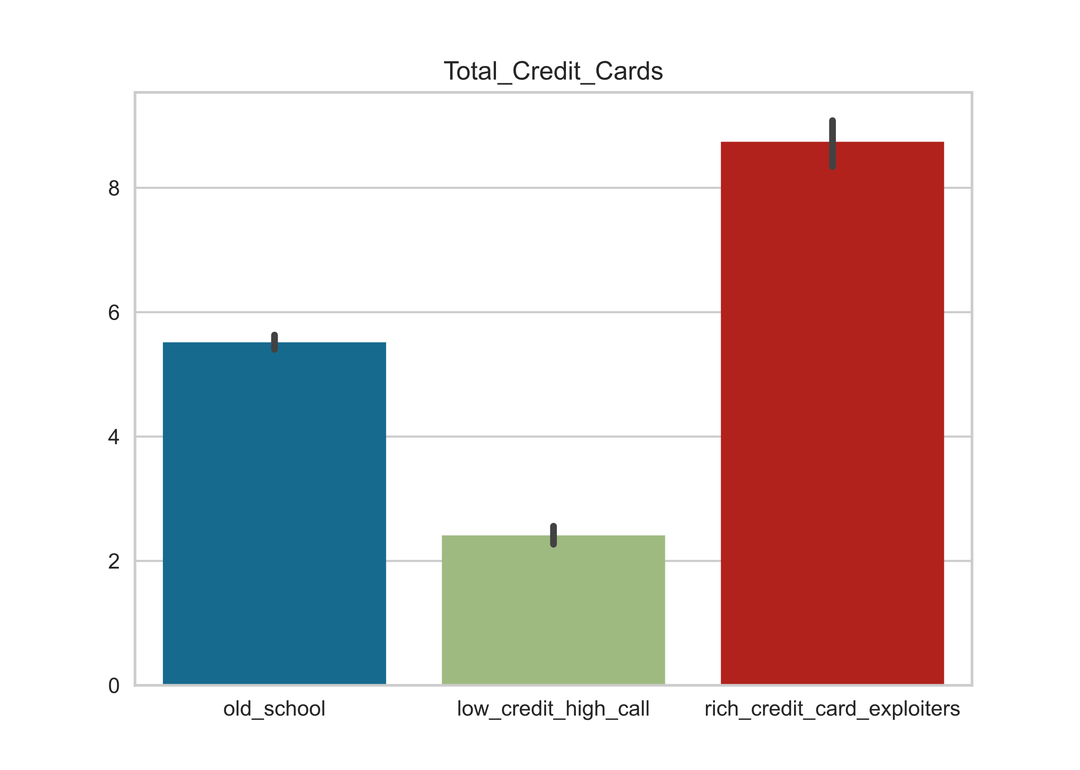
The Groups
Low Credit High Call
More credit cards = higher limit?

Slide 9
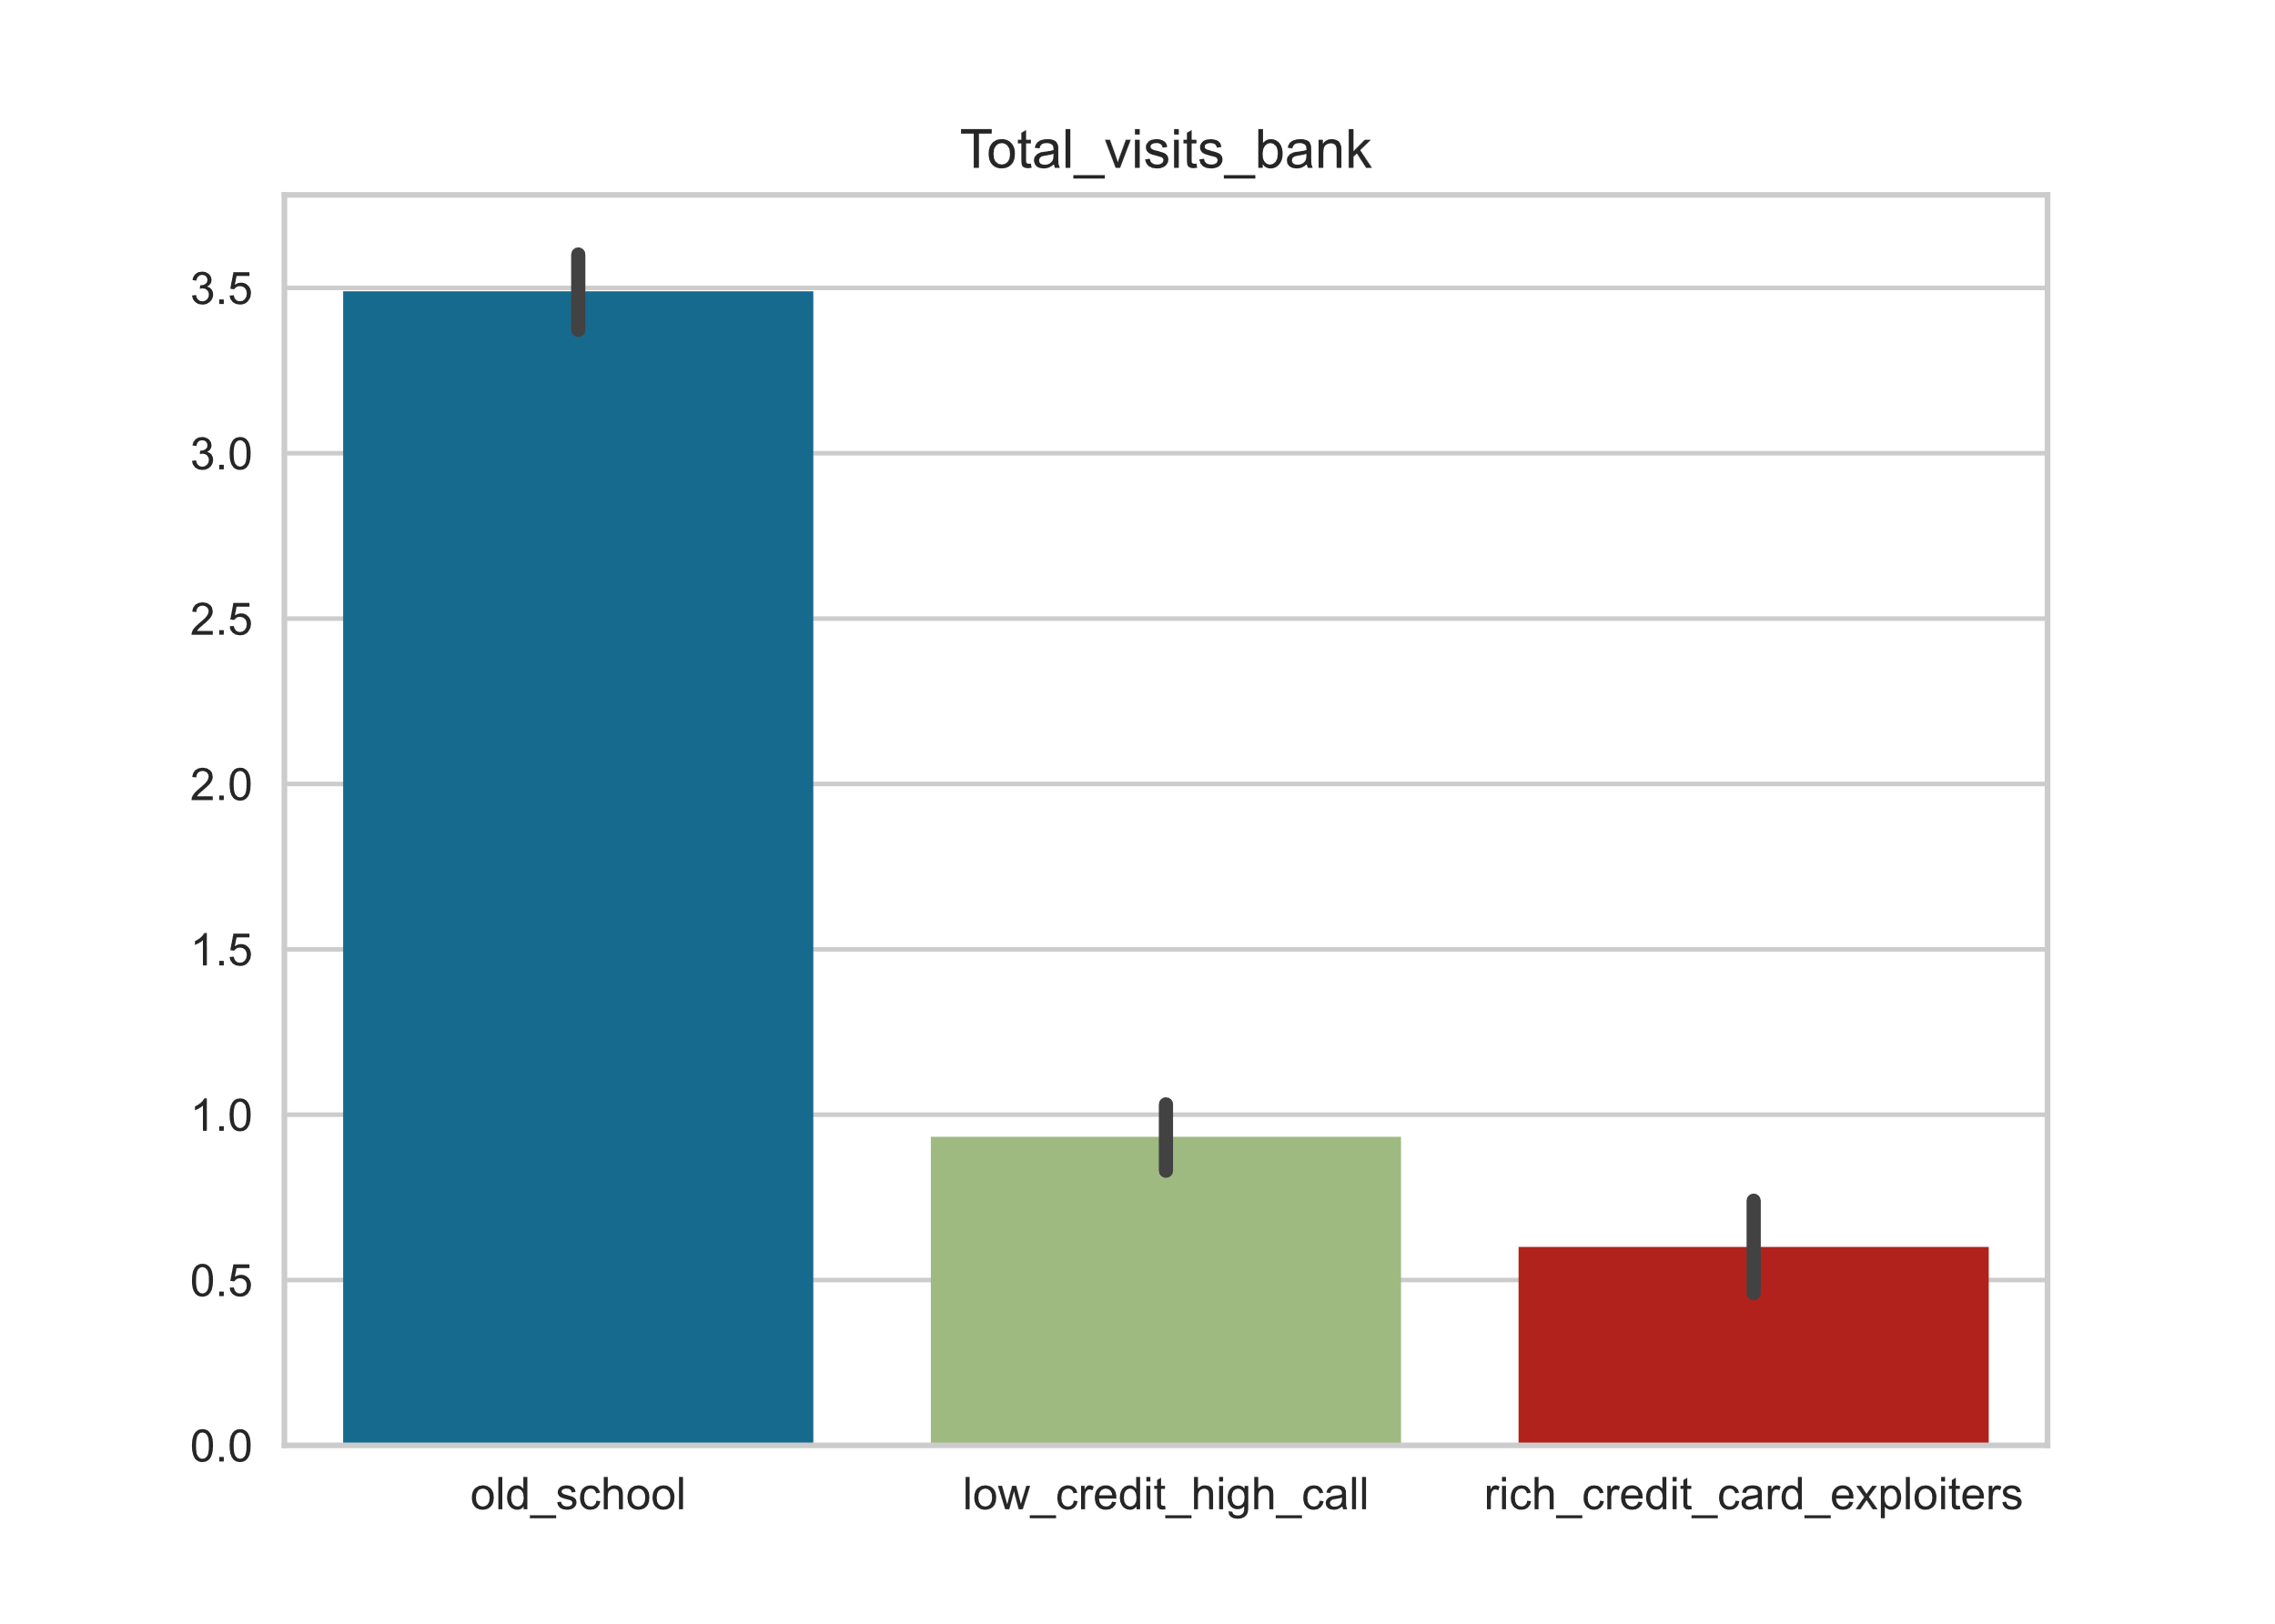
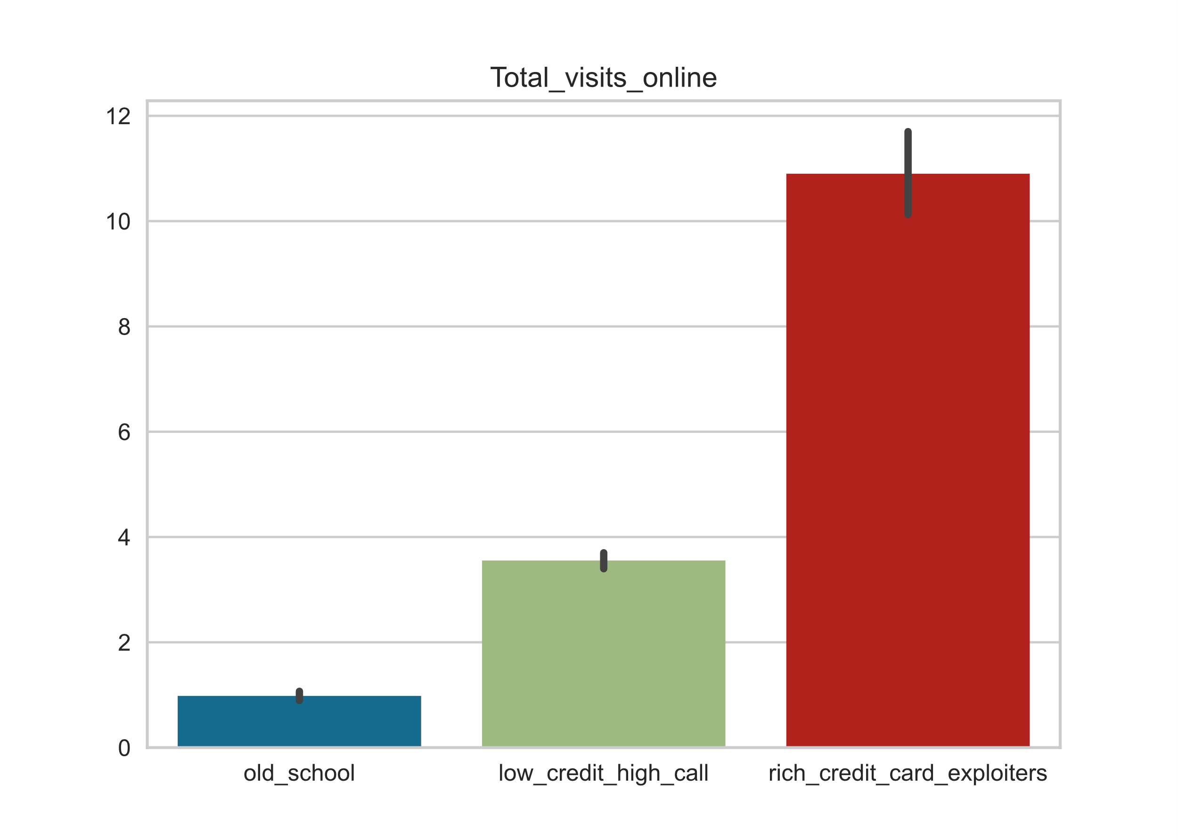
The Groups
Old School likes to go to the bank
And doesn’t like to use the internet
Inverse relationship between going to the bank and visiting the bank online?

Slide 10
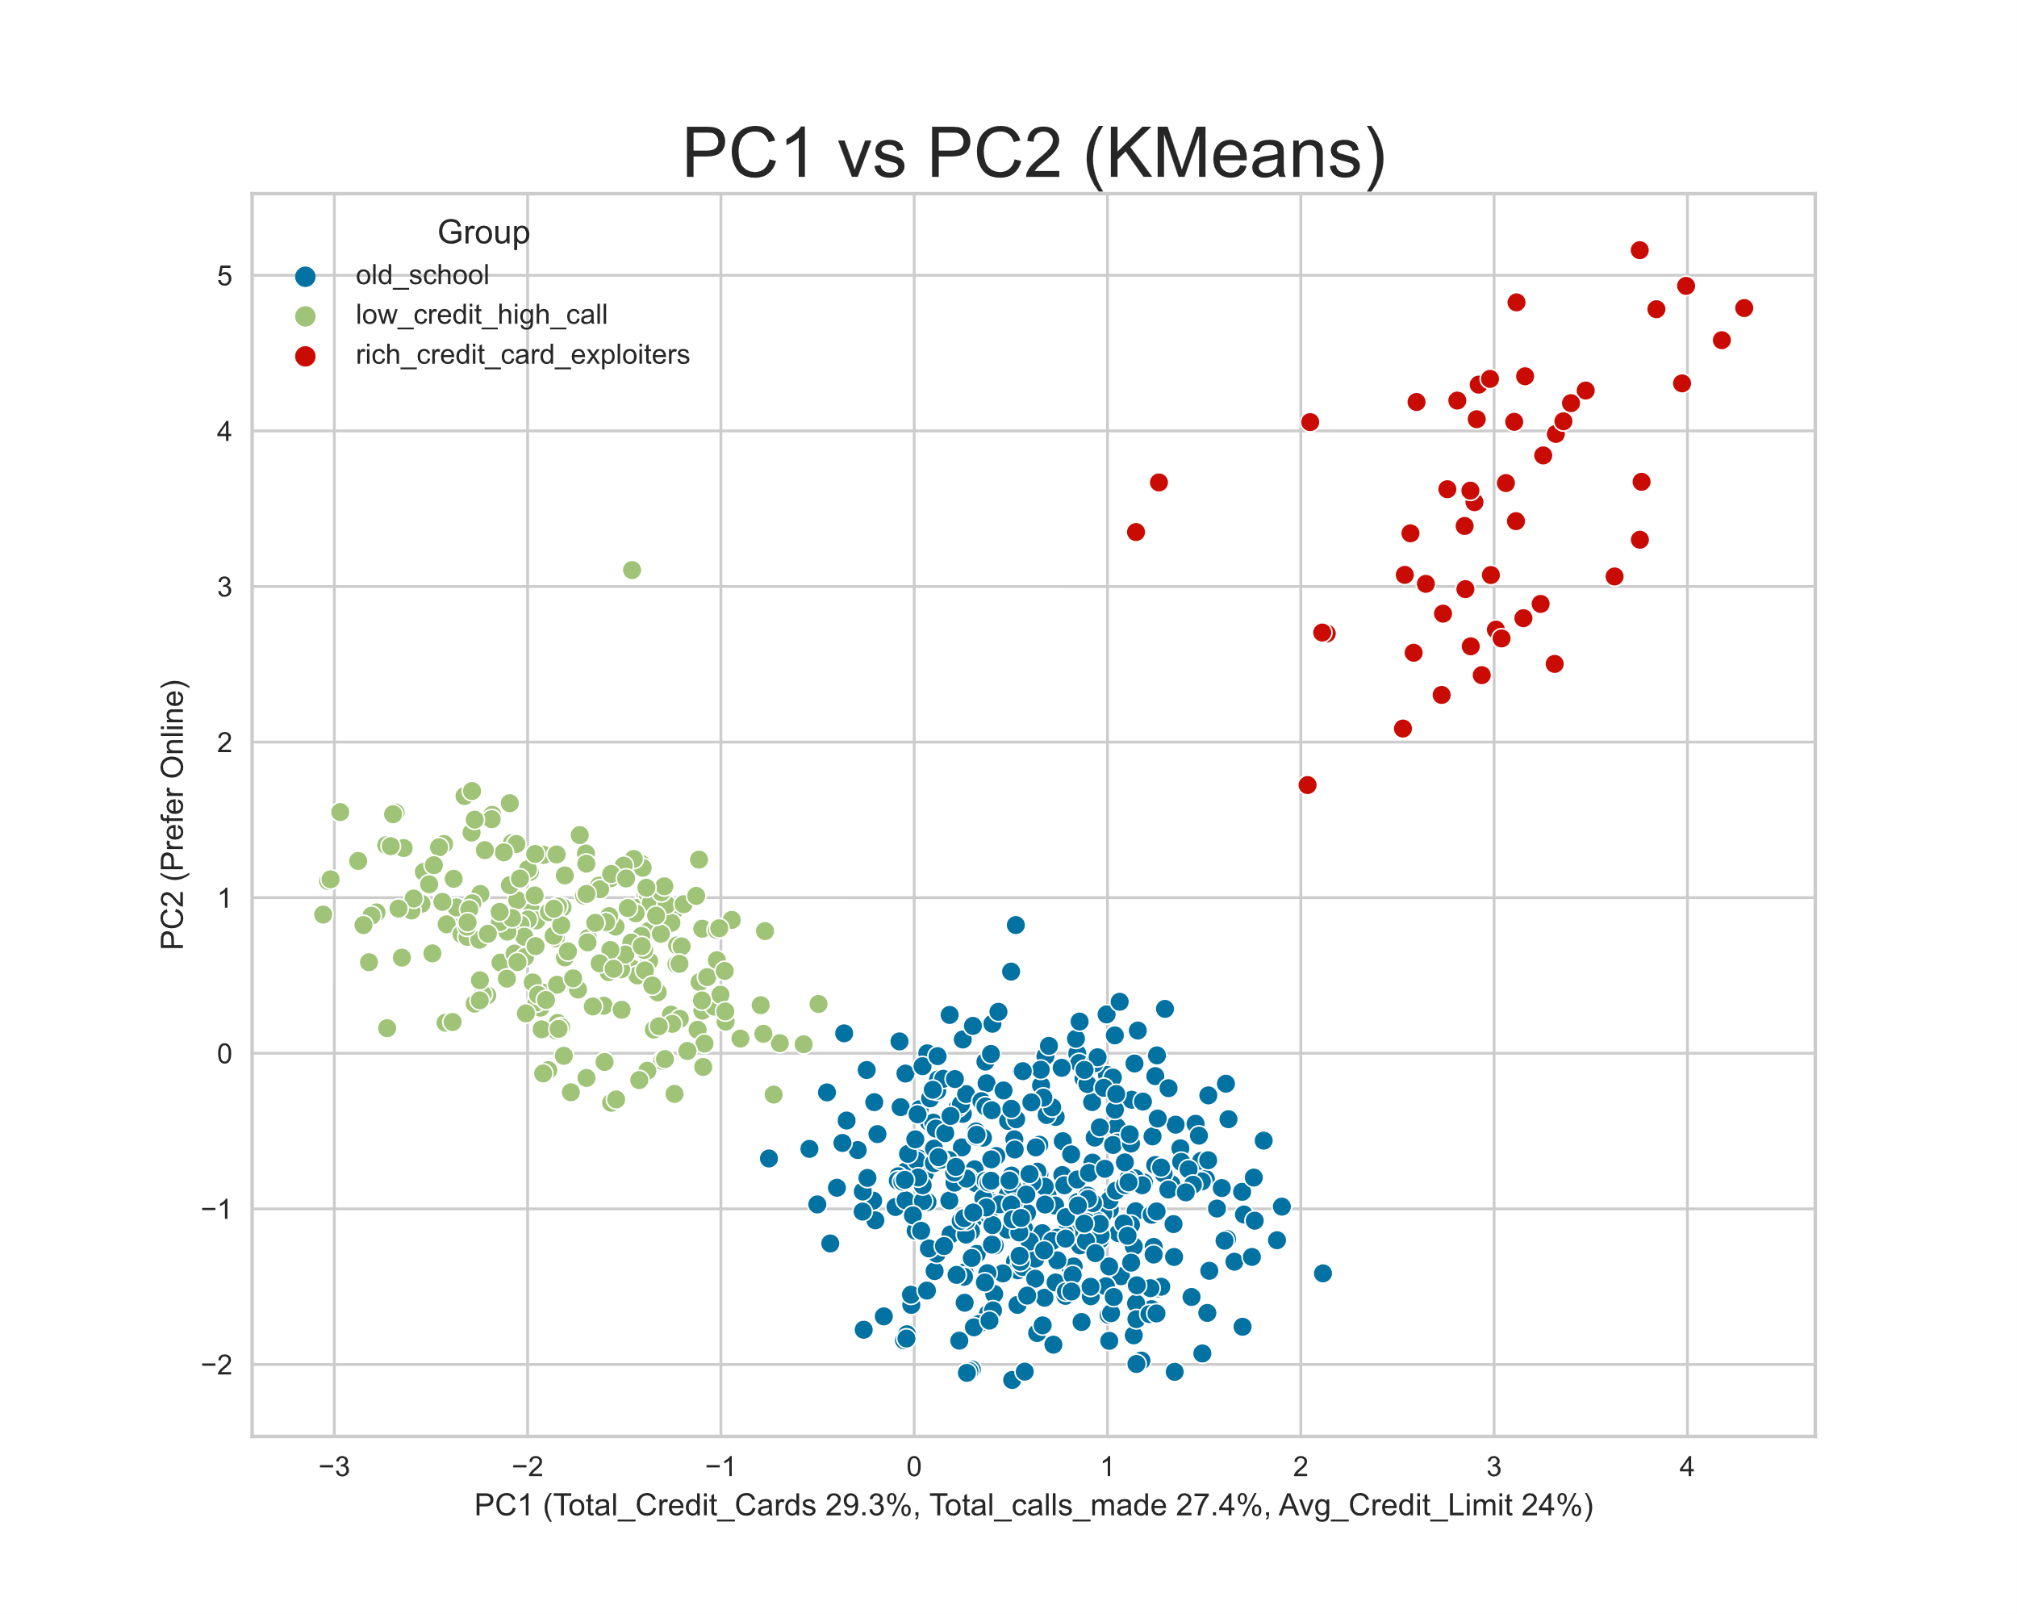
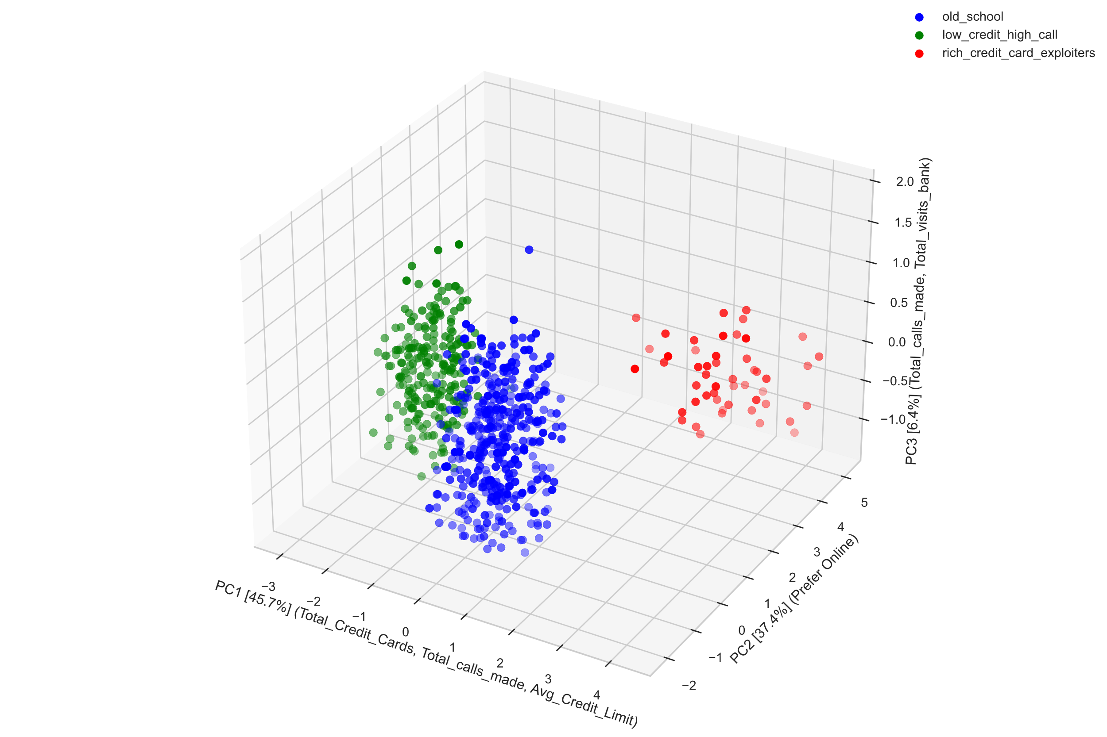
Back to PCA
 | Avg_Credit_Limit | Total_Credit_Cards | Total_visits_bank | Total_visits_online | Total_calls_made
PC1 | 0.489 | 0.598 | 0.280 | 0.112 | -0.559
PC2 | 0.403 | 0.030 | -0.587 | 0.665 | 0.224
PC3 | 0.003 | -0.285 | -0.614 | -0.305 | -0.670
PC4 | 0.309 | -0.741 | 0.445 | 0.318 | -0.236
PC5 | -0.709 | 0.105 | 0.051 | 0.592 | -0.364

Slide 11
Thank you!
max.dinkelspiel@gmail.com

